Slide 1
Data Carving

Slide 2
Overview
What is data carving?
Examining image signatures using xxd
Extracting images from a corrupted Word document using bless
carving embedded files
Carving a USB image using scalpel
carving deleted files

Slide 3
What is data carving?
A well-known computer forensics term
aka file carving
To identify and extract (carve) the file
from unallocated clusters/corrupted file header
without the assistance of the file system that originality created the file.
How to extract files?
based on signature information alone.

Slide 4
Example scenarios
Scenario 1: A file (A) is hidden inside of another file (B). You can’t open the file B because the B’s header is corrupted.
Scenario 2: A suspect deleted files. The files contains an important information. A file occupies a few clusters. Unfortunately, some clusters are reused (overwritten) by new files.
A forensic expert really wants to recover files, even a partial files.

Slide 5
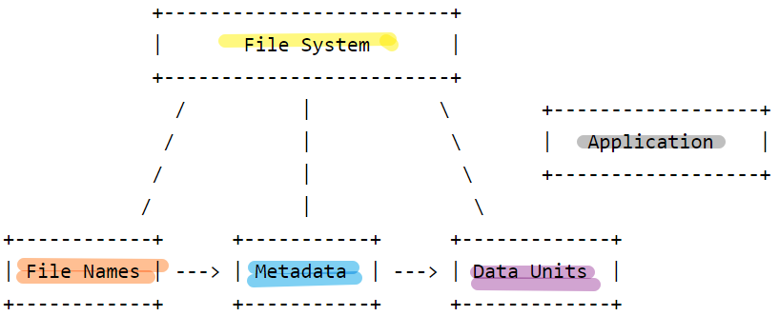
Approach- Search for File signature
The data units is saved independently from
file name and metadata
The content of a file is enclosed by
file signatures (header and tail)
What is file signature?
referred to as a magic number,
a constant numerical/text value
used to identify a file format

Slide 6
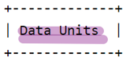
Data Unit internal structure
Header signature
(Optional)
Header information
content
Content
(Optional)
Tail signature
Tail information

Slide 7
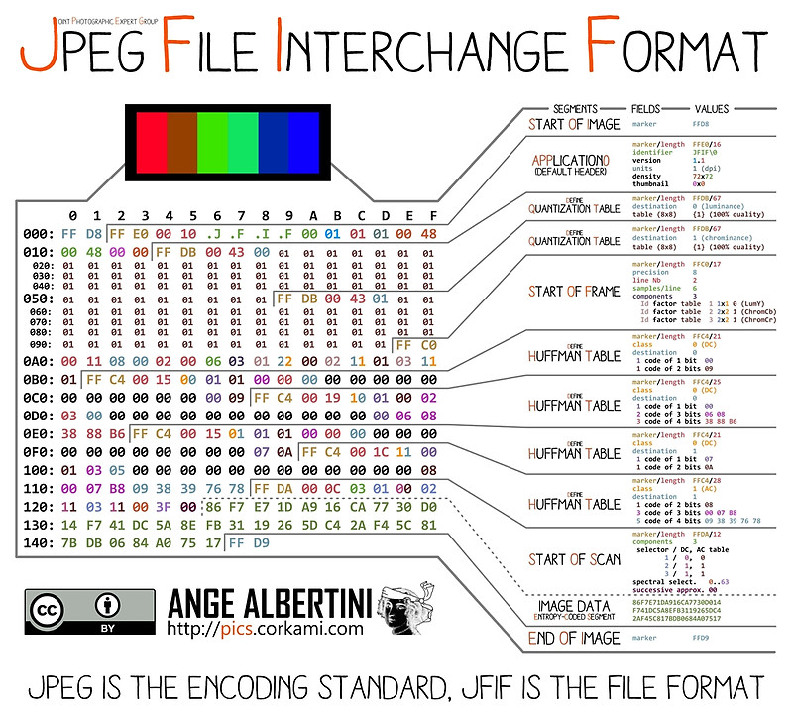
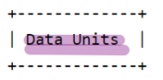
An example of Picture Data Unit
Notes:
https://www.offshoreclippingpath.com/difference-between-jpg-and-jpeg/

Slide 8
Compressed content- Huffman Coding
JPEG Image Compression
Invented by David Huffman
a graduate student at MIT in 1952
as part of his course work.
Huffman coding can be used to compress all sorts of data.
It is an entropy-based algorithm that relies on an analysis of the frequency of symbols in an array.

Slide 9

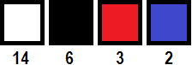
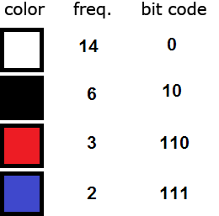
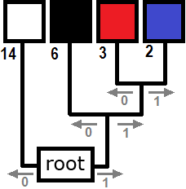
Each pixel requires 14 bits = 2³ (row)+2³ (col)+2⁸ (color)
(000)(100)(11111111)
Total: [6 (position) + 8 (color) ]*25=250
Before compression
sort the colors in order of decreasing frequency.
traverse from root to each color
colors farthest from the root are the least frequent.
Total bits required after compression:
25 x 6 (position)+
14 x 1 + 6 x 2 + 3 x 3 + 2 x 3 (color)
= 150+41 =191
Compression process
After Compression
Notes:
https://www.print-driver.com/stories/huffman-coding-jpeg

Slide 10
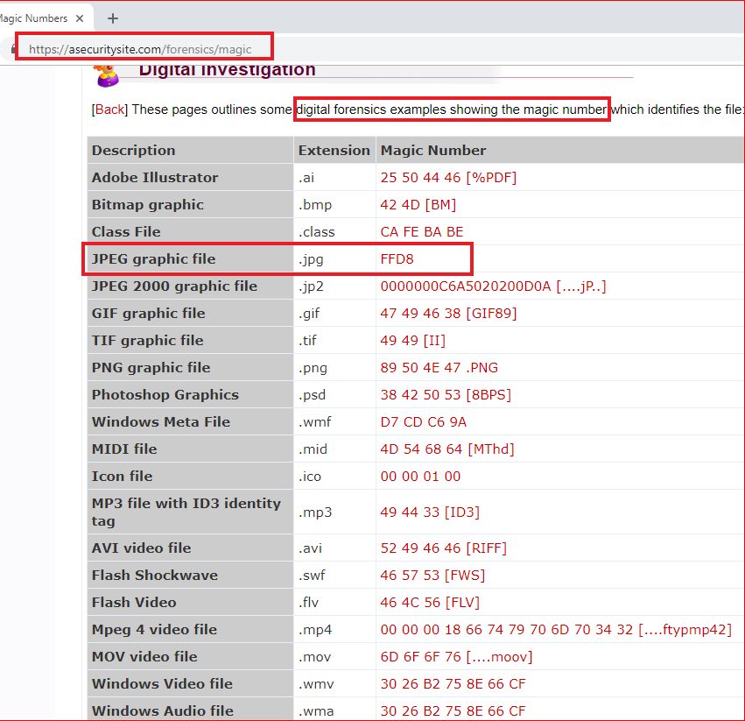
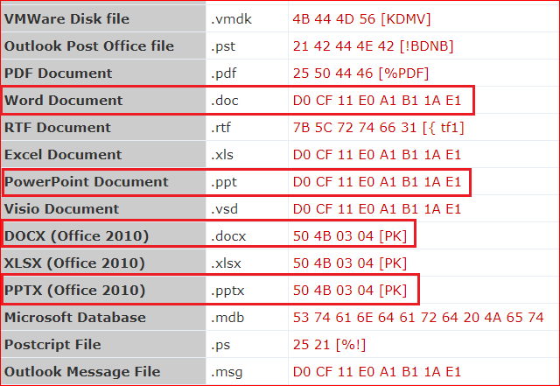

Slide 11
Examining image signatures
using xxd

Slide 12
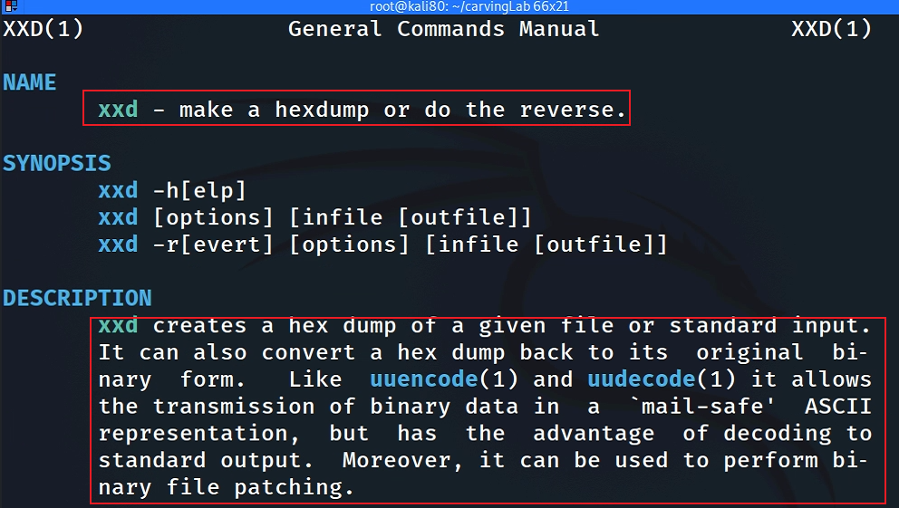
What is xxd?

Slide 13

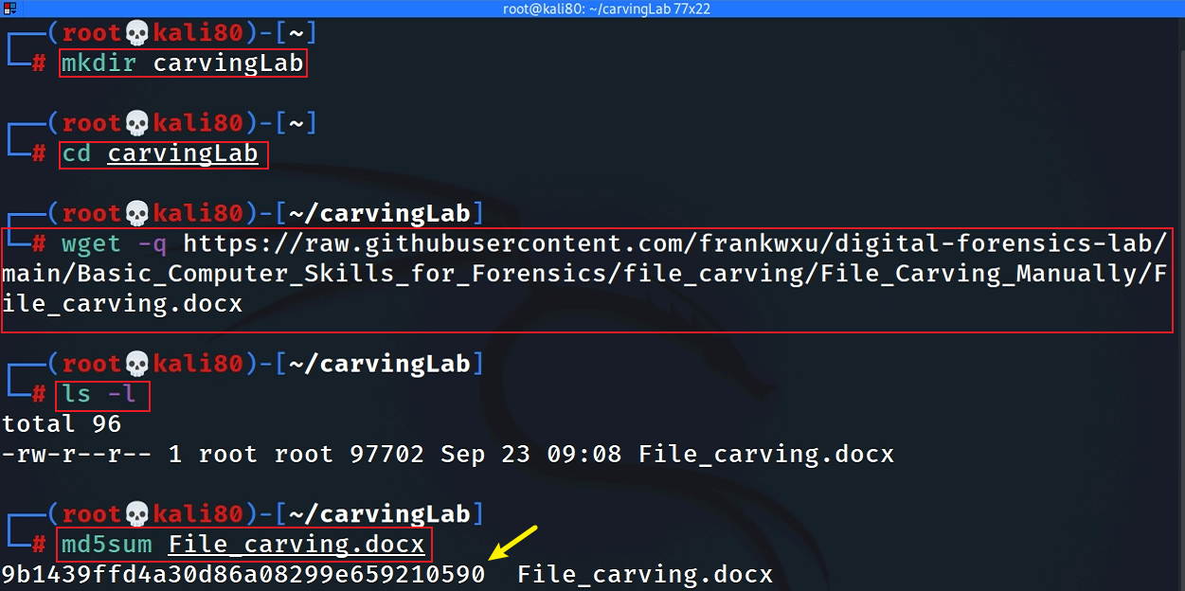
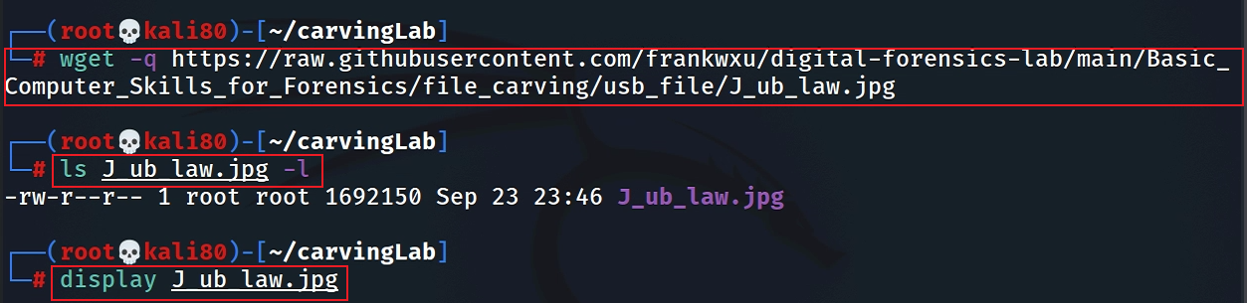
Get a jpg to show signature
Notes:
wget -q https://raw.githubusercontent.com/frankwxu/digital-forensics-lab/main/Basic_Computer_Skills_for_Forensics/file_carving/usb_file/J_ub_law.jpg

Slide 14
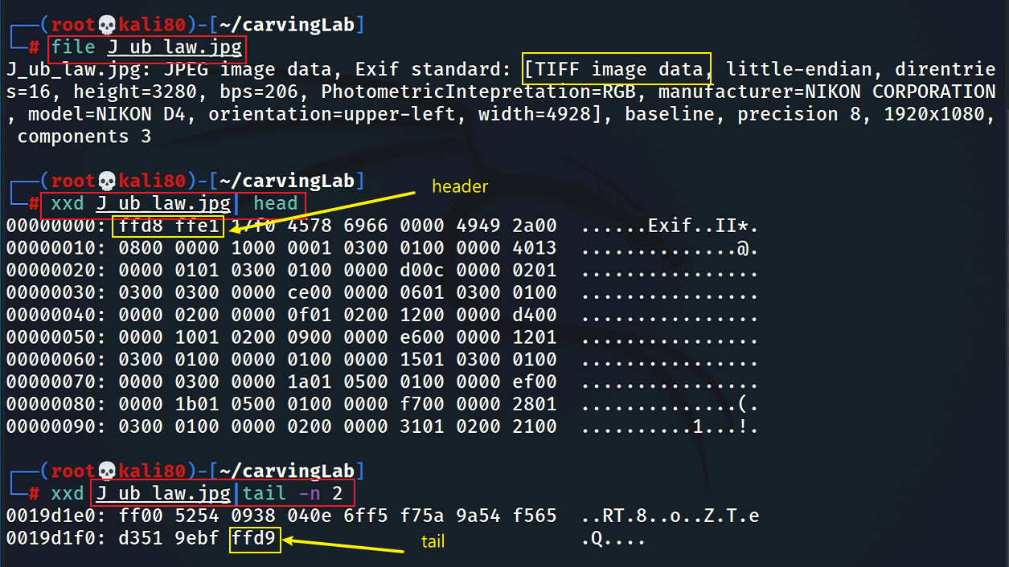
Show JPG header and tail signatures
The picture is taken by NIKON D4

Slide 15
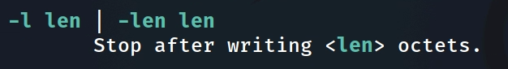
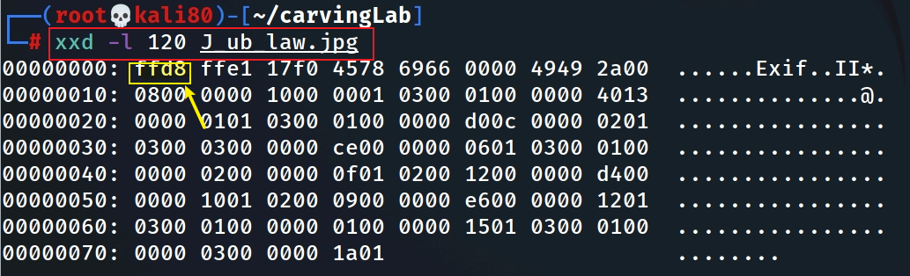
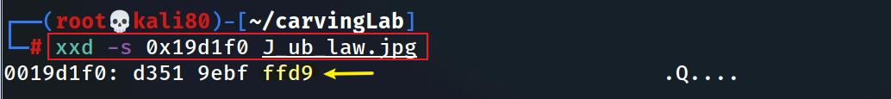
Alternative: Show JPG header and tail signatures
Alternative: Hexdump the first 120 bytes
Alternative: Hexdump the first 120 bytes

Slide 16
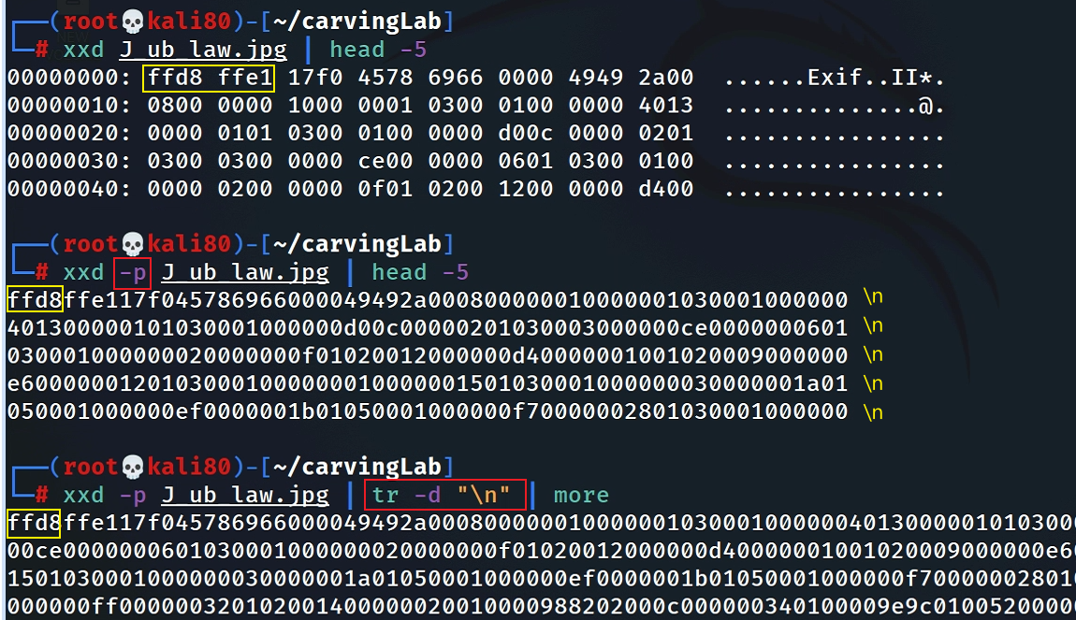
Search signatures in plain hexdump
Convert hexdump to plain hexdump
space causes search problem if we want to search “ffd8ffe1” . Will show it in next slide

Slide 17
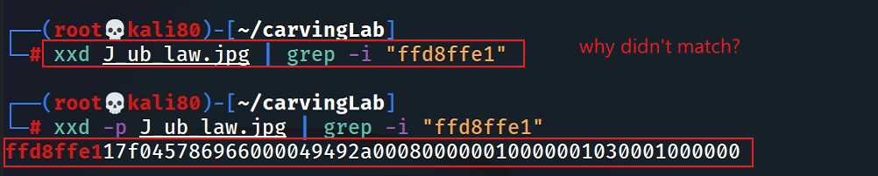
Search header in plain hexdump
Search tail in plain hexdump
How to search hex numbers between 2 lines? e.g., 0105?

Slide 18
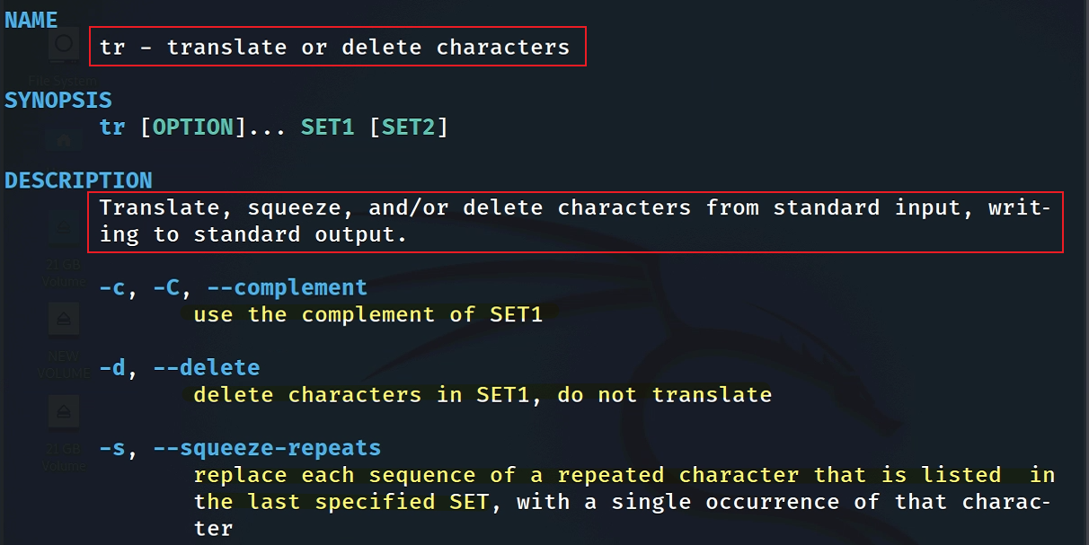
remove newline “\n”
tr command introduction

Slide 19

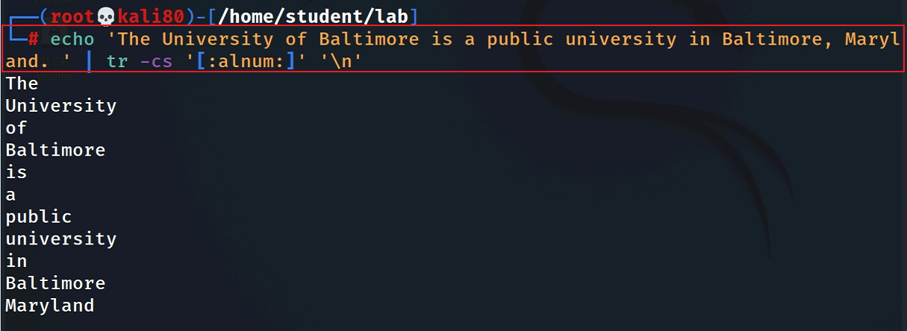
A small tr example: match all non-alphanumerical characters and replace them with a new line
Two tasks:
replace
Squeeze “\n” using the last set
Notes:
echo 'The University of Baltimore is a public university in Baltimore, Maryland. ' | tr -cs '[:alnum:]' '\n'

Slide 20
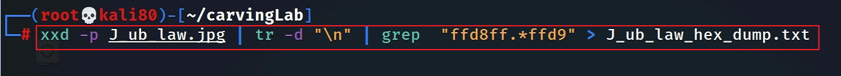
Dump the content between header and tailer signature
Match plain hexdump between header and tail signature and save the plain hexdump to a textfile
Notes:
xxd -p J_ub_law.jpg | tr -d "\n" | grep - o "ffd8ff.*ffd9" > J_ub_law_hexdump.txt

Slide 21
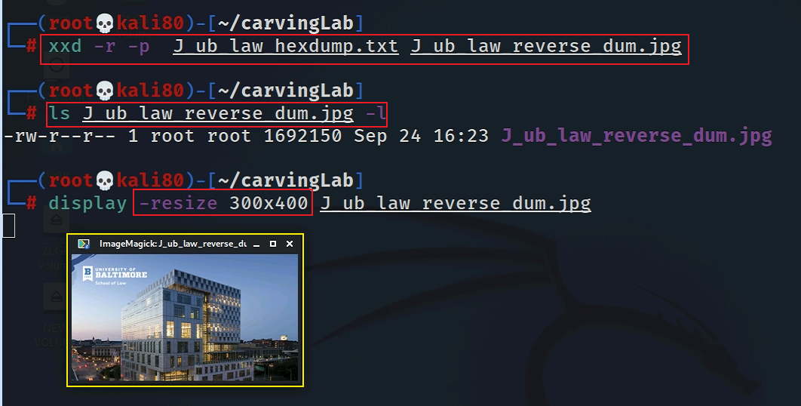
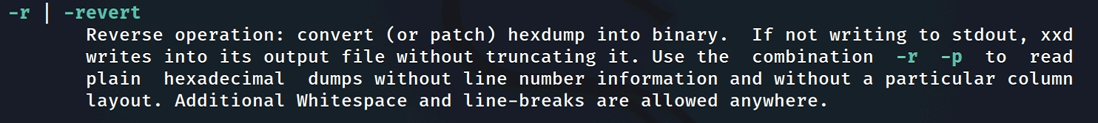
Convert a plain hexdump to back into binary
Notes:
xxd -r -p J_ub_law_hexdump.txt J_ub_law_reverse_dum.jpg

Slide 22
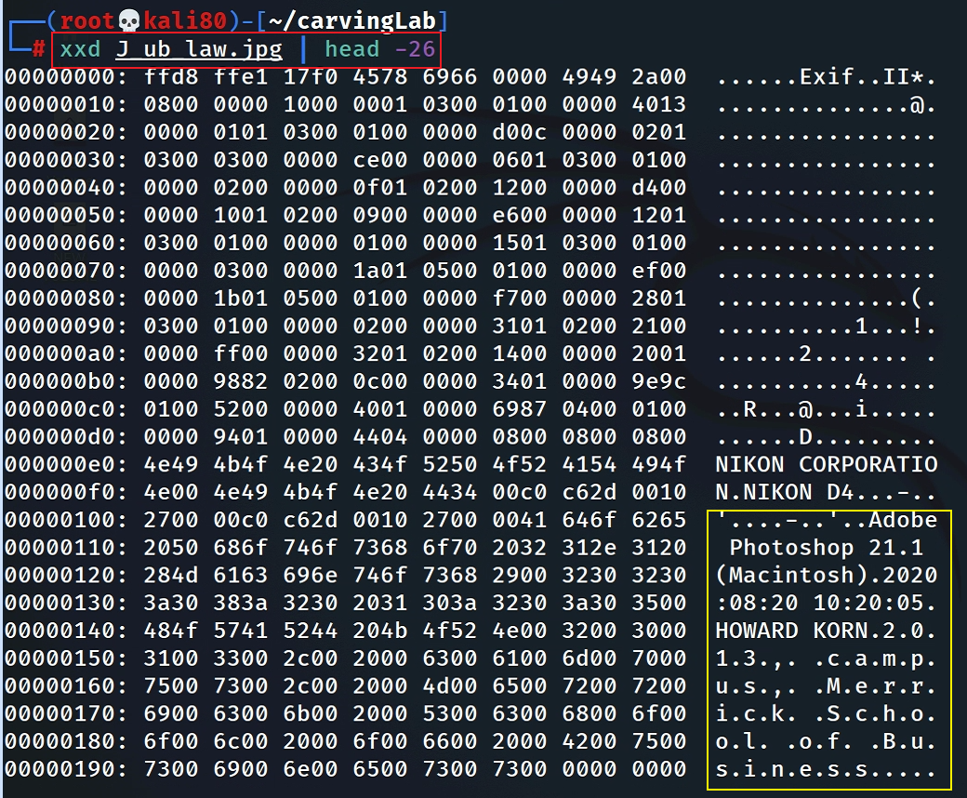
Interesting evidence in file header

Slide 23
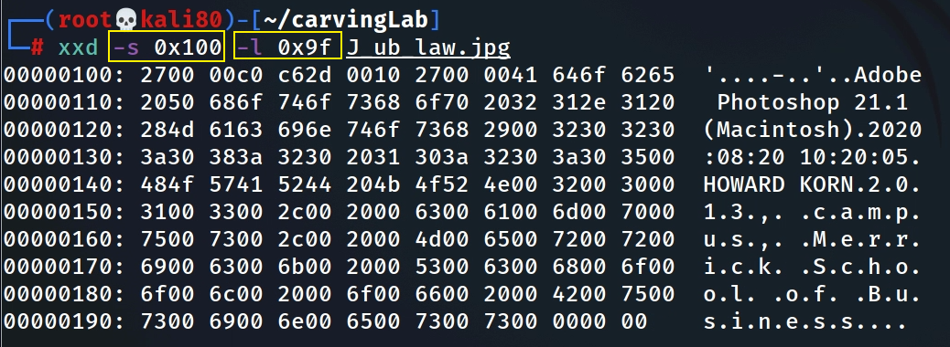
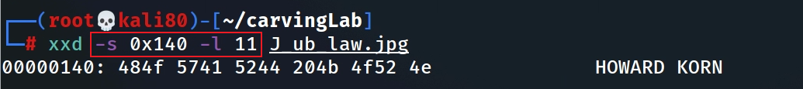
Hexdump Photoshop infor starts from 0x100 and list 0x9f bytes
Hexdum the name
Notes:
xxd -s 0x100 -l 0x9f J_ub_law.jpg

Slide 24
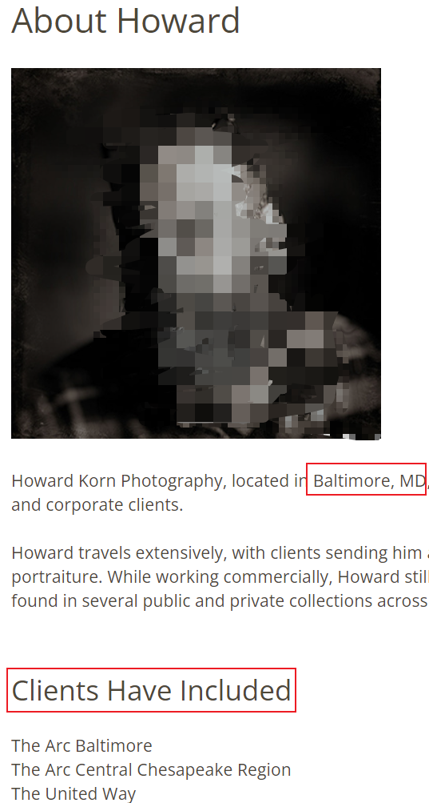
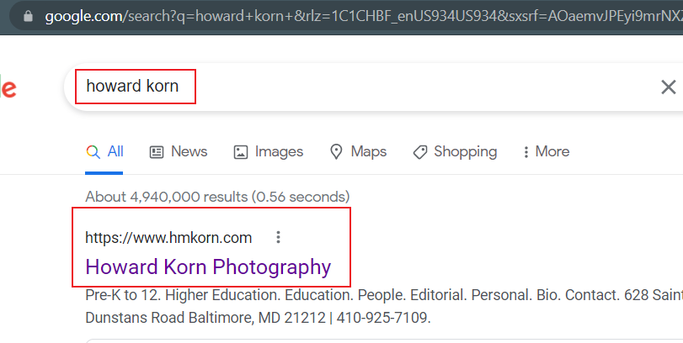
Who is Howard Korn?

Slide 25
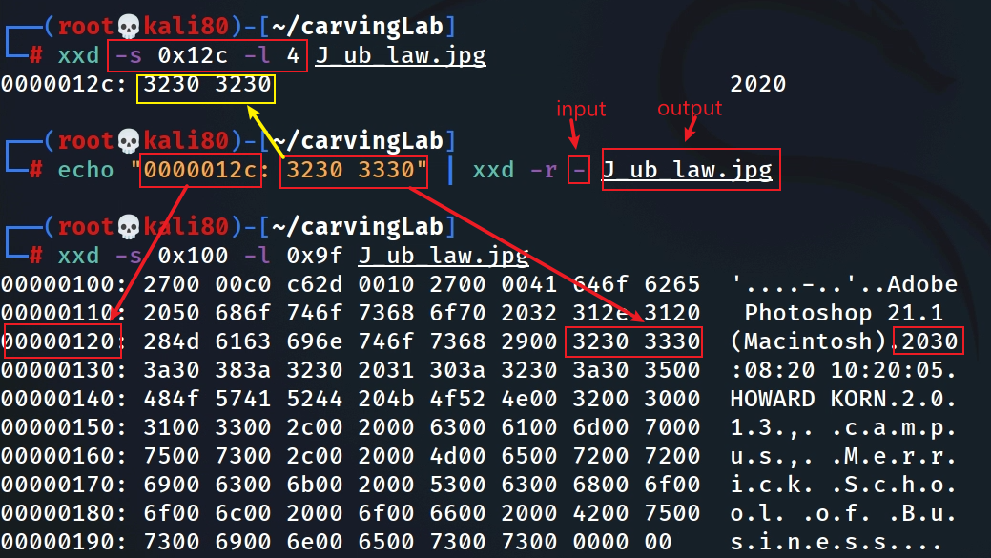
Fake the date (2020 -2030)
Hexdump the year
xxd reverses hexdump to binary (read from standard input. Overwrite 2020 with 2030)
If infile is specified as a `-' character, then input is taken from standard input.

Slide 26
Security implications
Modify software function
unlimited resource for games
Bypass security check
authentication
Insert malicious code
backdoor

Slide 27
Extracting images from a corrupted Word document
using bless

Slide 28
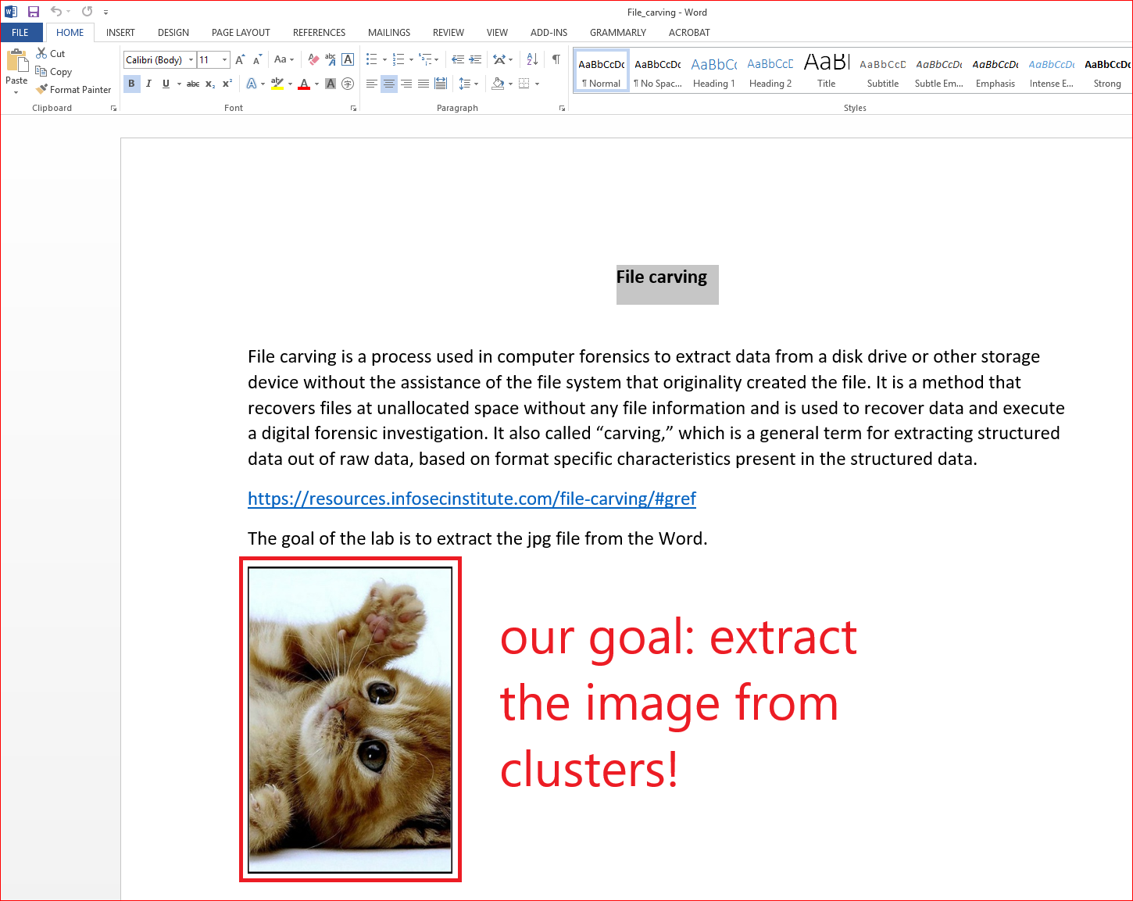
We can’t open the file because the file is corrupted (accidentally or intentionally)!
How to corrupted a file?

Slide 29
Prepare required files for the lab
the file we need
Notes:
wget -q https://raw.githubusercontent.com/frankwxu/digital-forensics-lab/main/Basic_Computer_Skills_for_Forensics/file_carving/File_Carving_Manually/File_carving.docx

Slide 30
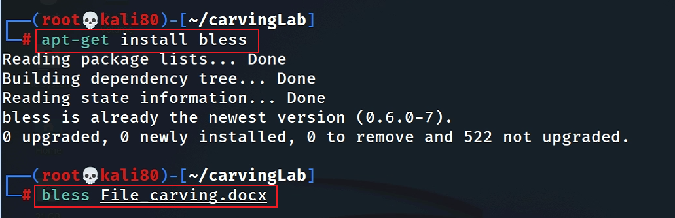
View the file in a hex editor

Slide 31
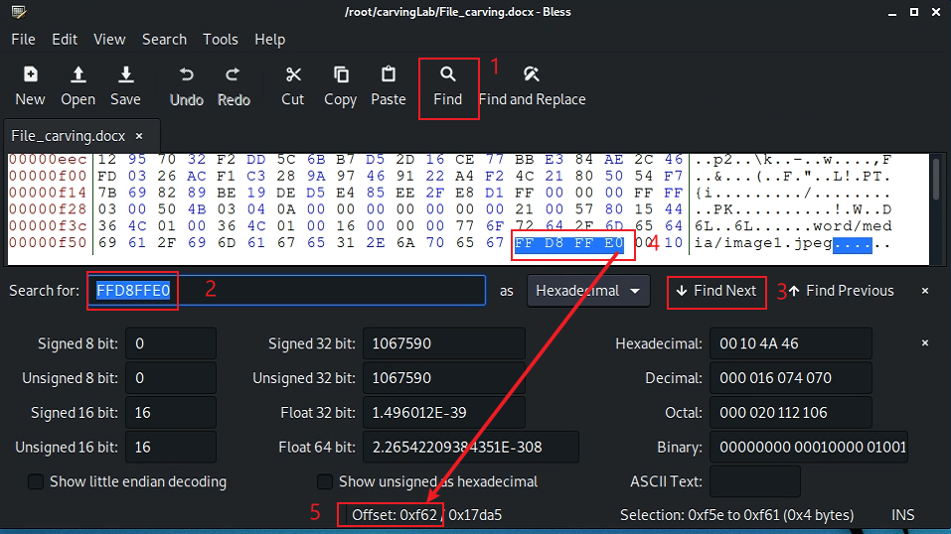
Search file header start offset – 0F5E
after the highlighted position

Slide 32
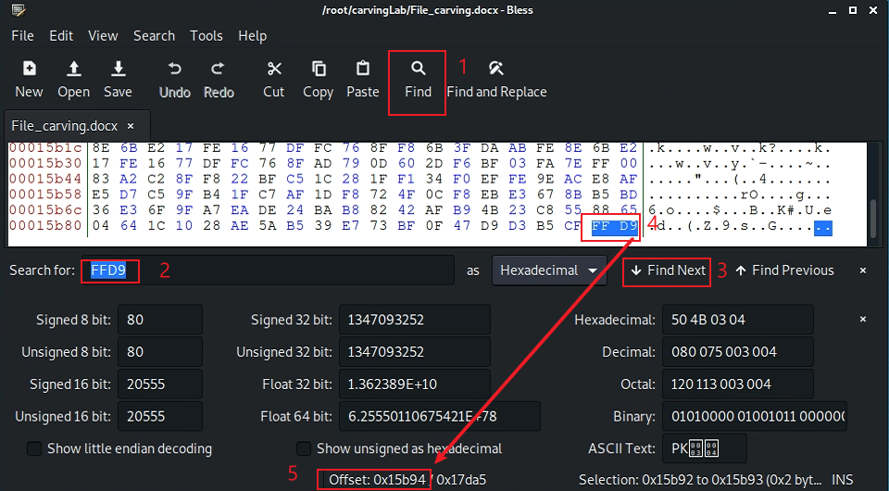
Search file trailer ends offset – 15B93
after the highlighted position

Slide 33
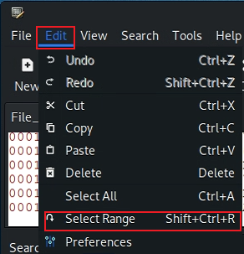
Select hex from header to tail
(0F5E)16=(3934)10
(15B93)16=(88979)10

Slide 34
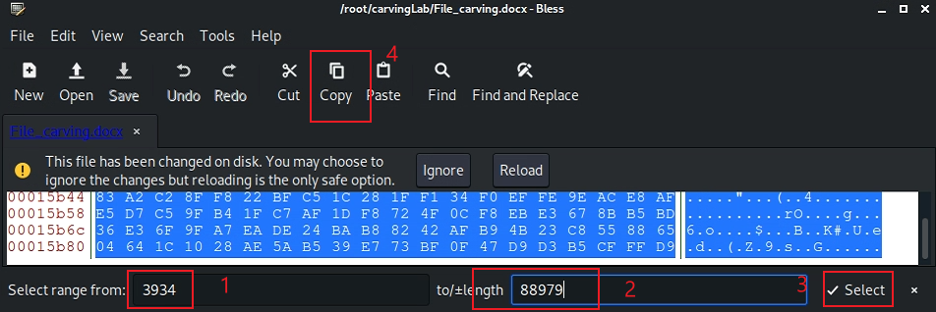
Copy the selection

Slide 35
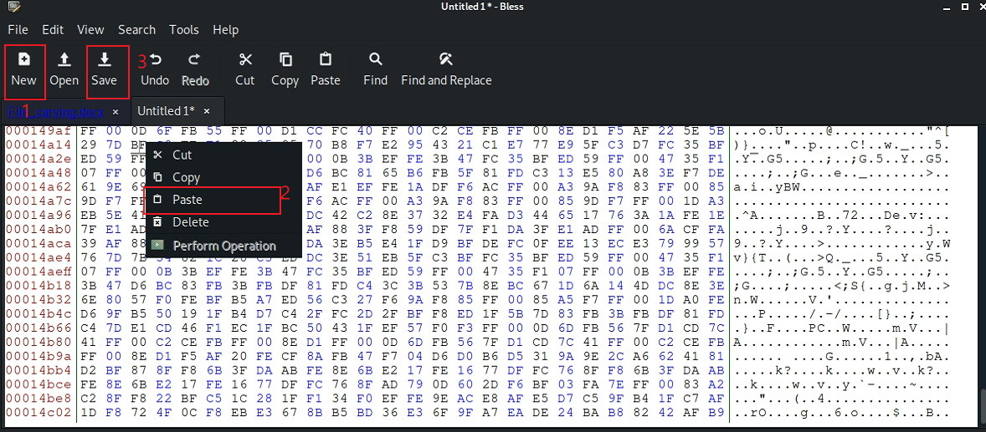
Paste the selection

Slide 36
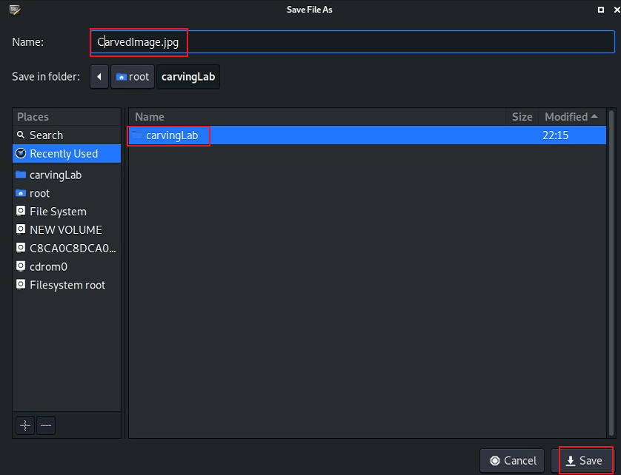
Save the image

Slide 37
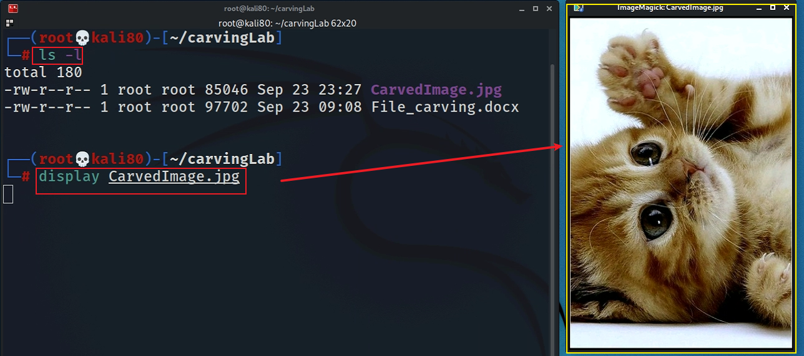
Show the carved image

Slide 38
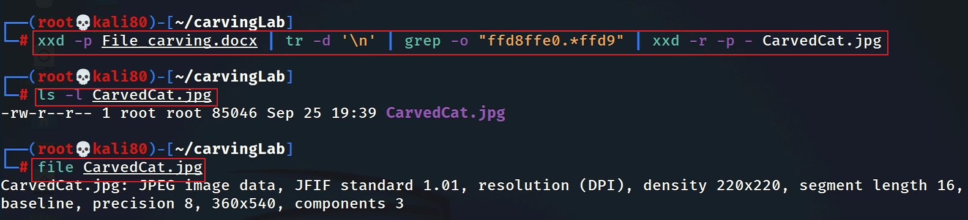
Alternative 1: using xxd
Must have –p, which tells xxd the input is a plain text
Notes:
xxd -p File_carving.docx | tr -d '\n' | grep -o "ffd8ffe0.*ffd9" | xxd -r -p - CarvedCat.jpg

Slide 39
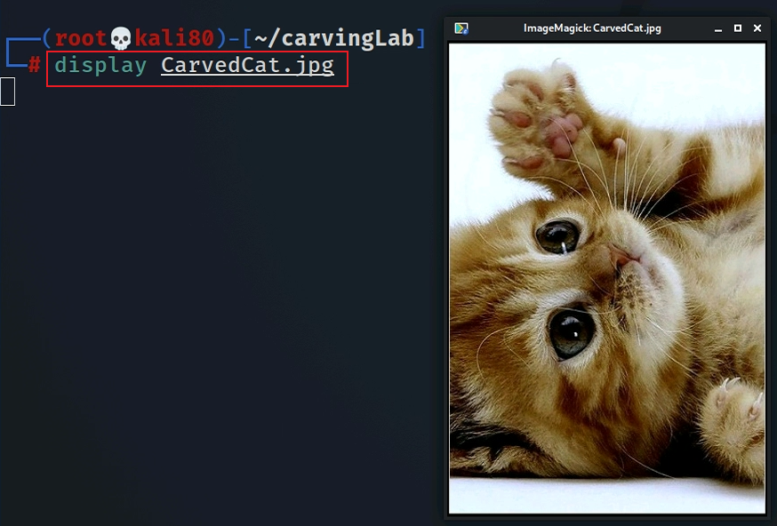

Slide 40
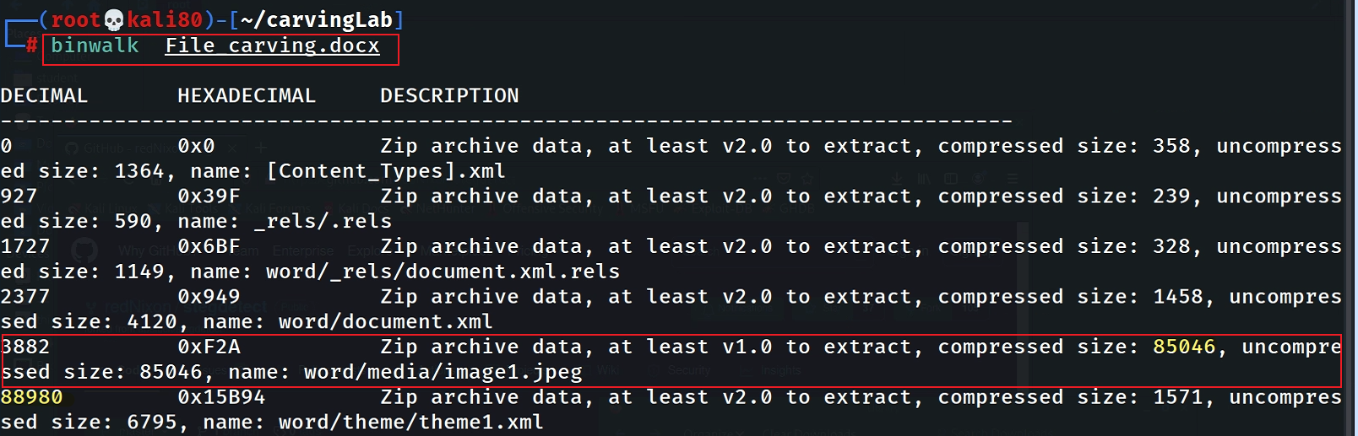
Alternative 2: using binwalk

Slide 41
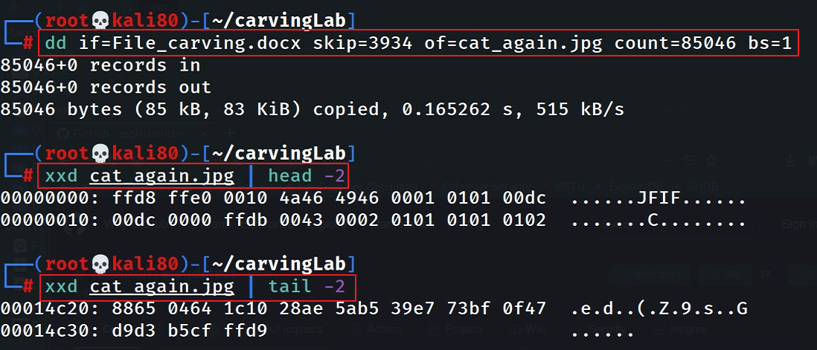
88980-85046=3934
Why not start from 3882? Word includes embedding header (48 bytes).

Slide 42
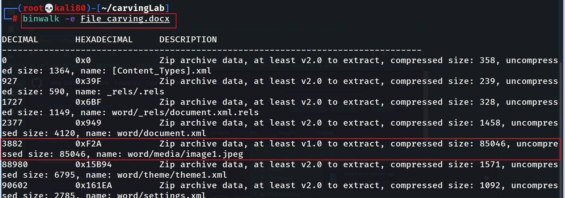
Alternative 3: using binwalk

Slide 43
Carving a USB image
using scalpel

Slide 44
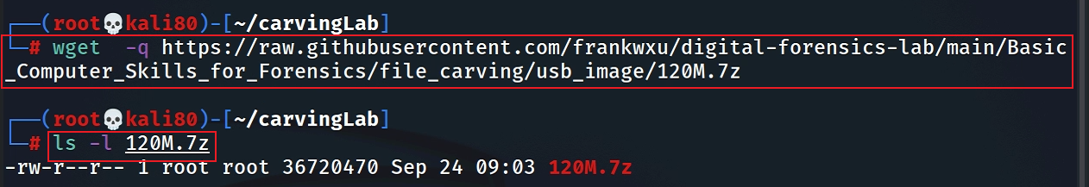
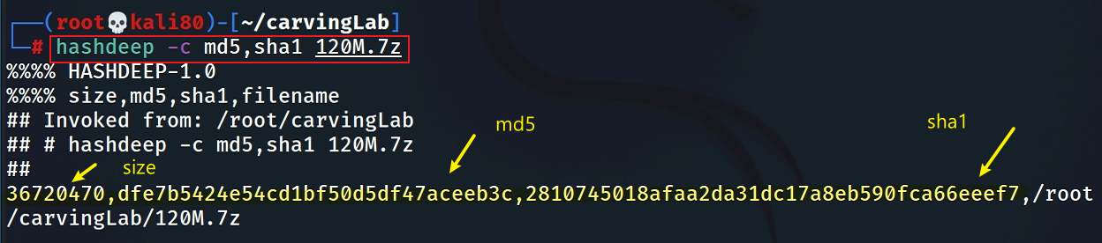
Prepare a USB image for file carving
Download the zipped USB image
Compute hashes
Notes:
wget -q https://raw.githubusercontent.com/frankwxu/digital-forensics-lab/main/Basic_Computer_Skills_for_Forensics/file_carving/usb_image/120M.7z

Slide 45
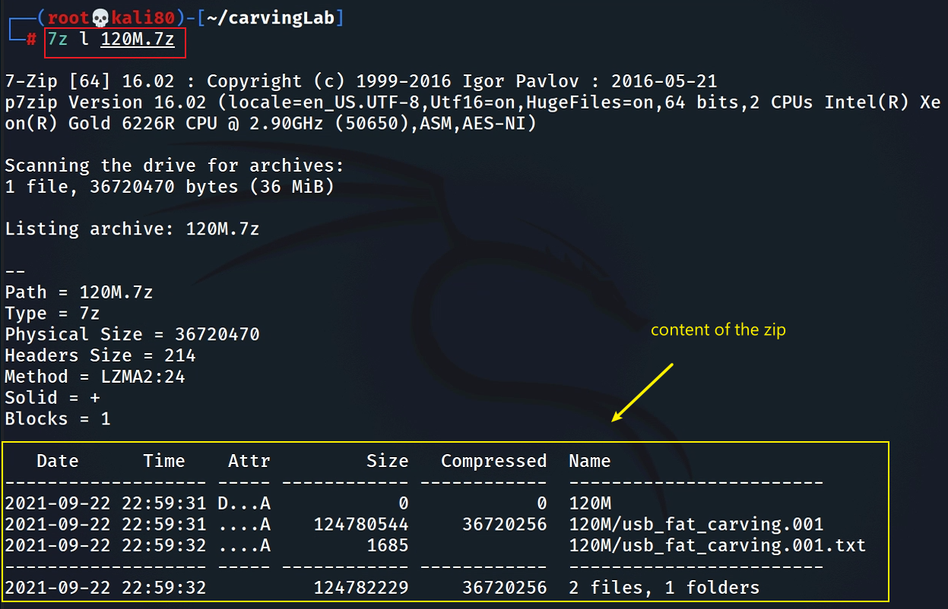
List the content of the zipped file

Slide 46
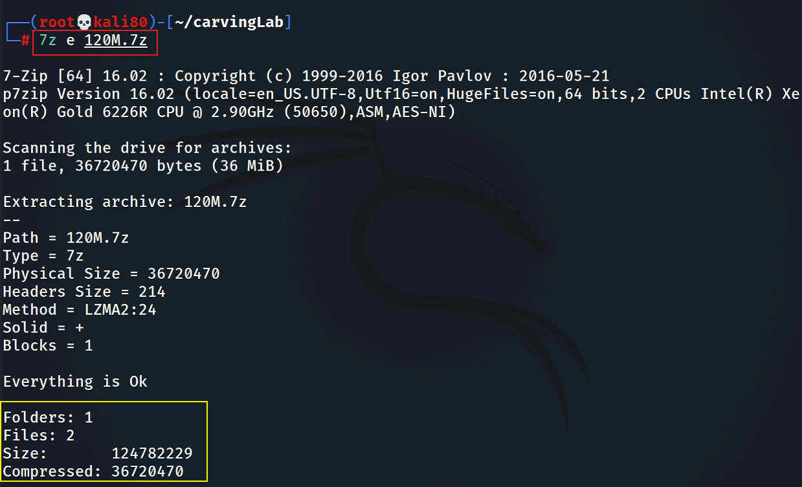
List the content of the zipped file
e : Extract files from archive (without using directory names)

Slide 47
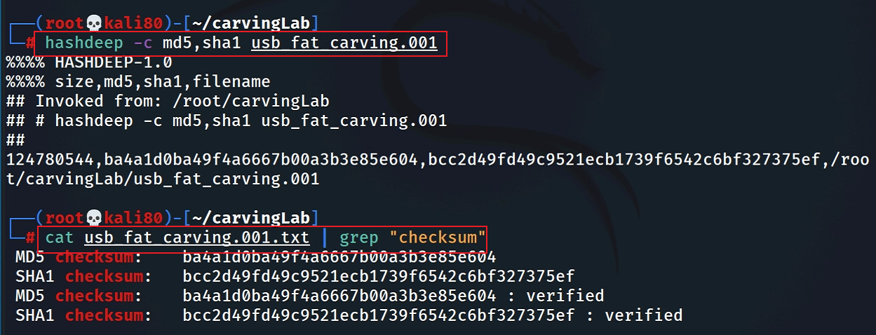
Verify the hashes

Slide 48
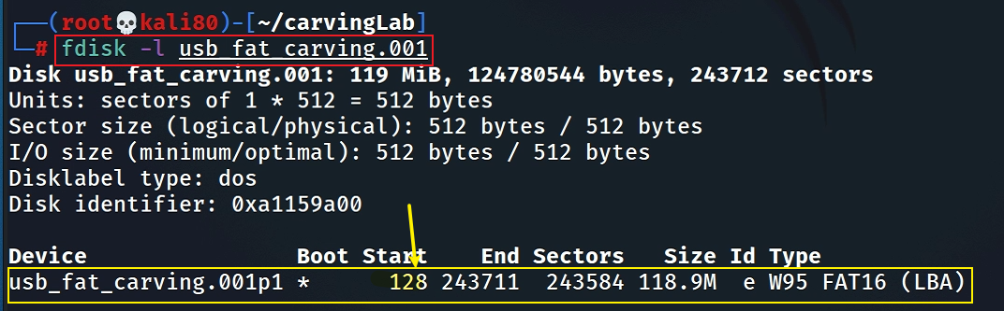
Exam the content of the USB
Display partitions

Slide 49
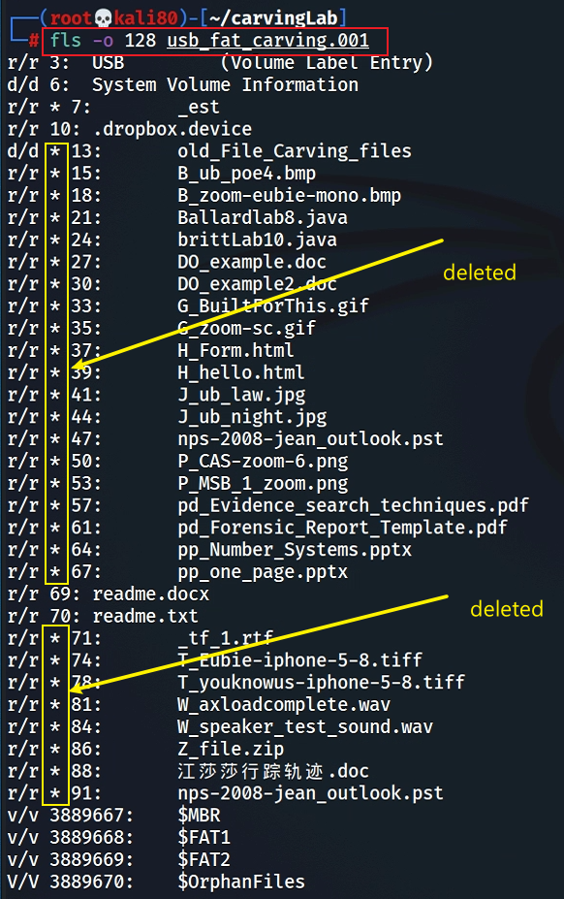
Find deleted files

Slide 50

Decide which file types need to carve
Save it and quit!

Slide 51

Show help

Slide 52

Carving the USB image

Slide 53

Show carved files

Slide 54

Show audit log

Slide 55


Display two carved jpg image

Slide 56
Summary
File header and tail signatures are used to identify file types
The content of a file is enclosed in header and tail signatures
Many tools can used for carving file content
Note the file names/metadata can’t be retrieved

